Slide 1
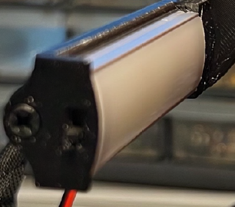
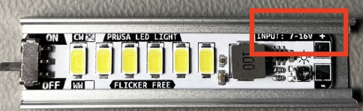
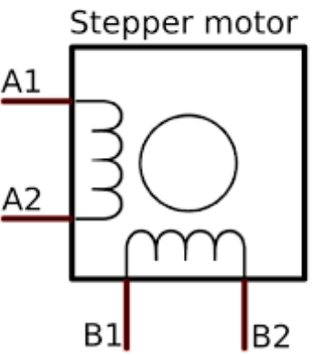
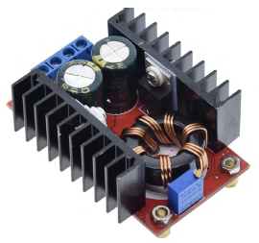
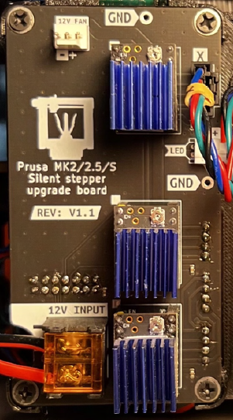
12 V
RAMBo
12 V
Power Supply
12 V
LED Bar
Control Signals
newer version LED Bar uses 24 V
Protection Circuit
Silent Driver
V1.1
24 V
12 V – 24 V
DC-DC Booster
24 VDC
Driver Signals
X
Y
Z
E
TMC2209
12 V/24 V

Slide 2
References
Custom Circuit Co. (Kevin Pettersson)
https://www.tindie.com/products/ccc/prusa-mk225s-silent-driver-upgrade-board/ - Silent Driver Board on Tindie
https://github.com/Kevin-Pettersson/Prusa_Silent_Upgrade_Board
https://github.com/Kevin-Pettersson/Prusa_Silent_Upgrade_Board/blob/main/Manuals/Prusa_upgrade_board_manual_V1.1.pdf
TMC2209/Stepper
https://hackaday.com/tag/tmc2209/
https://hackaday.io/page/21264-tmc5160-vs-tmc2209-what-are-differences
https://hackaday.com/2022/06/13/protect-your-drivers-when-the-motor-stalls/
https://hackaday.com/2016/09/30/3d-printering-trinamic-tmc2130-stepper-motor-drivers-shifting-the-gears/
https://biqu.equipment/products/bigtreetech-tmc2209-stepper-motor-driver-for-3d-printer-board-vs-tmc2208
https://github.com/bigtreetech/BIGTREETECH-TMC2209-V1.2/blob/master/manual/TMC2209-V1.2-manual.pdf
https://www.analog.com/en/products/tmc2209.html
TMC2209 Amazon
https://amzn.com/dp/B07YW7BM68 - BigTreeTech
https://amzn.com/dp/B09BK57KNY - Teyleten Robot
Prusa
https://forum.prusa3d.com/forum/original-prusa-i3-mk2-s-multi-material-general-discussion-announcements-and-releases/what-stepper-motor-do-i-have/

